Slide 1
Dockerized Node.js Application deployment
Karthikeyan K
Kasthuri R

Slide 2
Agenda
Overview of the Project
Application Code and Dockerfile
Jenkins Pipeline Workflow
Demo Walkthrough (with CI/CD flow)
Conclusion and Q&A

Slide 3
Project Overview
Goal: Create a simple Node.js web application and deploy it on an EC2 instance.
Tools Used:
Node.js: Web application backend
Docker: Containerize the application
Jenkins: Automate the CI/CD process
GitHub: Store the source code
EC2: Host the deployed application

Slide 4
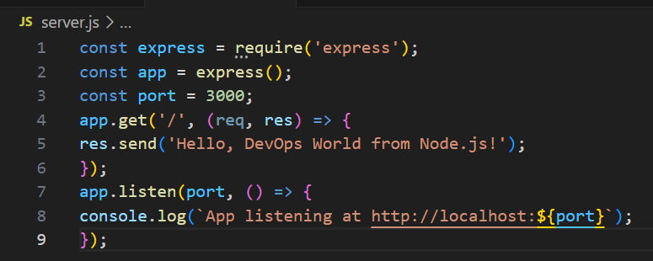
Application Code Overview
Functionality: A simple Express server responding with a message.
Port: Exposing port 3000.

Slide 5
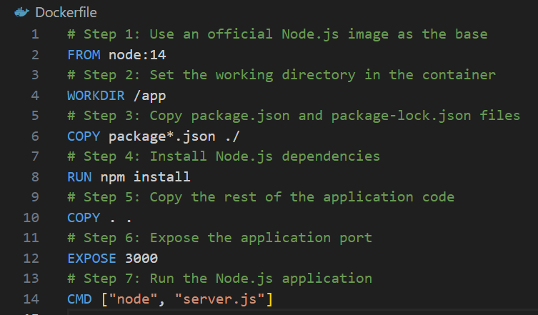
Dockerfile

Slide 6
Jenkins Pipeline Overview
Jenkins Pipeline Pipeline Workflow:
Clone Repository: Fetches code from GitHub.
Build Docker Image: Creates a Docker image for the application.
Push to Docker Hub: Uploads the image to Docker Hub.
Deploy to EC2: Pulls and runs the image on an EC2 instance.

Slide 7
Demo Walkthrough
Step 1: Jenkins fetches the code from GitHub.
Step 2: Builds the Docker image and tags it as latest.
Step 3: Pushes the image to Docker Hub.
Step 4: Connects to EC2 using SSH and deploys the container.
Output:
Web Application accessible on http://<EC2-IP>:3000.
Displays: "Hello, DevOps World from Node.js!"

Slide 8
Key Learnings
CI/CD Automation: Automated build and deployment with Jenkins.
Docker Containers: Simplified application packaging and deployment.
Scalable Deployment: Easily deploy applications to cloud platforms

Slide 9
Conclusion
Successfully built and deployed a Node.js application using Docker and Jenkins.
Demonstrated an automated CI/CD pipeline with deployment to EC2.
Github Repo:
https://github.com/KasthuDhiva/docker-node-app

Slide 10
Thank you

